Slide 1


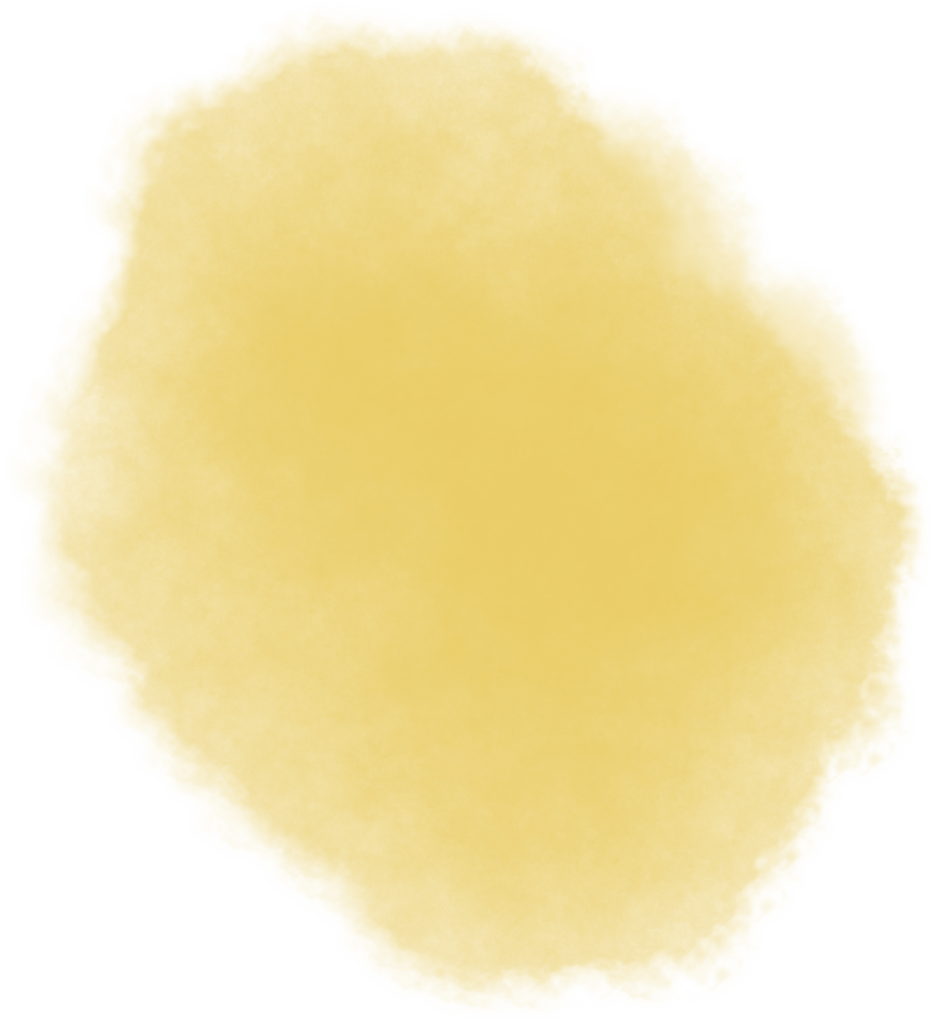
PYTHON BASICS
DAY-1

Slide 2
WHAT IS PYTHON
Python is a most popular general - purpose programming language.
Scripting language
High Level Language
Interpreter Language
Interactive Language
Procedure Oriented Language
Functional Oriented Language
Object Oriented Language
Purely Object Oriented Language
Modular Programming Language
General Purpose Language

Slide 3
Scripting Language
All interpreter-based languages are called scripting languages.
Since Python is an interpreter-based language, it is called a scripting language.
Scripting languages are open-source and can be modified at any time.
An interpreter does not generate an executable file; it always executes the source code directly.
Hence, in Python, there is no concept of an executable file only source code is executed.

Slide 4
High Level Language
Python is a user-friendly language, similar to English, making it easy to read and write.
It abstracts complex hardware-level details, making development simpler and faster.

Slide 5
Interpreter based Language
Python code is processed at runtime by the interpreter — there is no need to compile the program before execution.
This behavior is similar to scripting languages like Linux Shell Scripting, Perl, and PHP.

Slide 6
Interactive Language
Python allows you to write and test code directly in the command line or shell, just like you do in a Linux terminal.
This makes Python ideal for quick testing, learning, and debugging.

Slide 7
Procedure-Oriented Language
A procedure-oriented language focuses on functions (also called procedures) to perform tasks.
The program is divided into smaller parts called functions, making it easier to manage and reuse code.

Slide 8
Functional-Oriented Language
A functional-oriented language focuses on functions as the core building blocks of a program.
It emphasizes:
Pure functions (no side effects)
Immutability (no changing state)
Function composition (building complex logic by combining simple functions)

Slide 9
Object-Oriented Language
An object-oriented language (OOP) focuses on objects and classes to organize code.
It supports key OOP concepts:
Encapsulation – hiding internal details
Abstraction – showing only essential features
Inheritance – reusing code from existing classes
Polymorphism – using a single interface for different data types

Slide 10
Purely Object-Oriented Language
In a purely object-oriented language, everything is treated as an object, including basic data types like numbers and functions.
You cannot write procedural code separately — everything must be inside a class or object.

Slide 11
Modular Programming Language
A modular programming language allows you to break a large program into smaller, independent modules.
Each module performs a specific task and can be developed, tested, and reused separately.
This approach improves:
Code organization
Reusability
Debugging and maintenance

Slide 12
General Purpose Language
A general-purpose language is designed to build a wide variety of applications, not limited to a specific domain.
It can be used for:
Web development
Data analysis
Automation
Game development
Machine learning
Scientific computing

Slide 13
Applications developed In Python
1. Web Development -
Python is widely used in web development thanks to powerful frameworks like Django and Flask.
These frameworks offer built-in tools for:
Routing
Templating
Database management
Popular companies using Python for web development:
Instagram, Pinterest, Spotify

Slide 14
Applications developed In Python
2. Scientific & Numeric Computing -
Python is a top choice in scientific computing and mathematics.
Key libraries:
NumPy – numerical computing
SciPy – scientific calculations
Pandas – data analysis and manipulation
Used for:
Statistical analysis
Complex computations
Data visualization

Slide 15
Applications developed In Python
3. Data Science, Machine Learning & AI -
Python dominates the world of Data Science, ML, and AI.
Top libraries include:
TensorFlow, Keras, PyTorch – for deep learning and model training
Scikit-learn – for machine learning algorithms
Applications:
Image recognition
Predictive modeling
Natural language processing (NLP)

Slide 16
Applications developed In Python
4. Business Applications -
Python is great for building business tools, such as:
Financial applications
Inventory management systems
Reporting & dashboards
Also used to automate repetitive tasks and handle large-scale data processing.

Slide 17
Applications developed In Python
5. Game Development-
Python can be used for basic 2D games using libraries like:
Pygame
Ideal for learning and prototyping, though less common in high-end game development.

Slide 18
Applications developed In Python
6. Scripting & Automation -
Python is a powerful scripting language for:
Automating repetitive tasks
File system operations
System administration
Helps boost productivity and efficiency.

Slide 19
Applications developed In Python
7. Desktop Applications -
Python supports GUI-based application development.
Popular frameworks:
Tkinter (built-in GUI toolkit)
PyQt, Kivy – for more complex apps
Can be used to build calculators, media players, editors, etc.

Slide 20
Applications developed In Python
8. Other Applications -
Python is also used in:
Blockchain development
Audio/Video processing
Web scraping (using BeautifulSoup, Selenium)
Chatbots and virtual assistants
Embedded systems and IoT

